Slide 1

Phishing Awareness Training
// DEFENDING THE HUMAN FIREWALL
Securing our data against the most common entry point for cybercrime.
Code Alpha - Phishing Awareness

Slide 2
The Human Element
90% of all cyberattacks begin with a single phishing email. Understanding how these attacks work is your first line of defense.

Slide 3






WHAT IS PHISHING?
Email Phishing
Smishing (SMS)
Quishing (QR)
Mass-distributed fraudulent emails designed to trick users into clicking links or downloading malware.
Phishing via text messages, often pretending to be banks or delivery services with urgent alerts.
A new trend where malicious links are embedded in QR codes, bypassing traditional email filters.

Slide 4

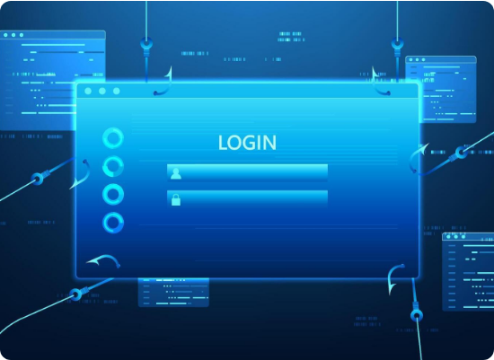
THE SPEED OF THE THREAT
Critical Statistics
21 Seconds: The median time it takes a user to click a phishing link after receipt.
28 Minutes: The time it takes for a user to report a suspicious email.
Steady Volume: 3.8 million phishing attacks recorded in 2025 alone.

Slide 5
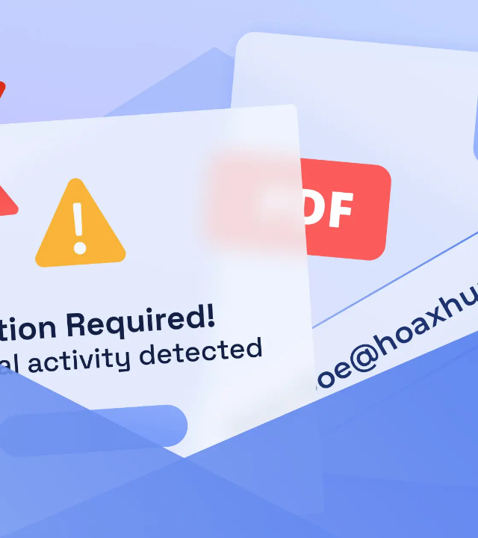
ANATOMY OF A PHISH
Identify the Red Flags
Modern phishing attempts are highly sophisticated, often using AI to craft perfect grammar and local branding.
Suspicious Sender: Check if the domain (e.g., @micros0ft.com) matches the real brand.
Sense of Urgency: Threatens account closure or legal action to force quick clicks.

Slide 6

SOCIAL ENGINEERING TACTICS
Pretexting
Baiting
Attackers create a believable backstory (the "pretext"). For example, posing as an IT technician needing your password for a "security audit."
Offering a prize or benefit—like a free software upgrade or a "confidential" HR document—to entice a user to download a malicious file.
"Social engineering is the art of manipulating people so they give up confidential information."

Slide 7
SPOTTING FAKE WEBSITES
Inspect the URL: Look for "homograph" attacks where 'o' is replaced by '0' or 'i' by '1'.
The Padlock Myth: A padlock (HTTPS) only means the connection is secure, not that the website itself is legitimate.
Data Harvest Pop-ups: Legitimate sites rarely ask for passwords in a separate, unprompted popup window.
Hover Before You Click: Always hover over links to see the true destination URL in your browser's bottom-left corner.

Slide 8
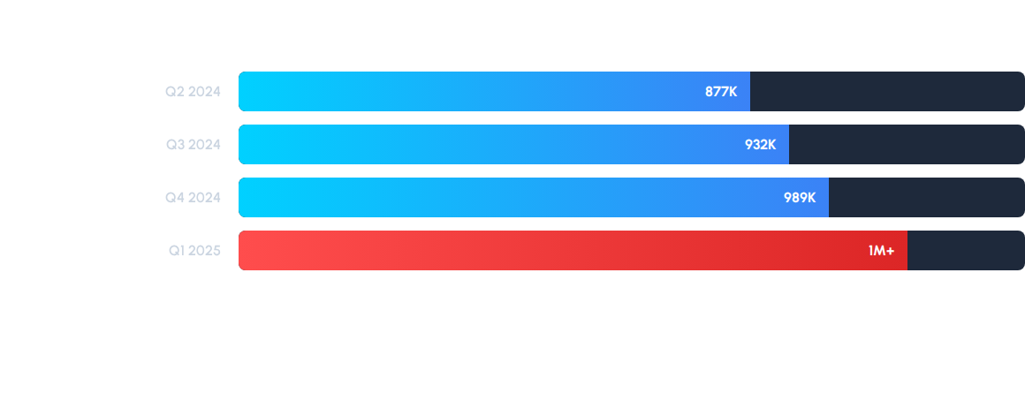
ATTACK TRENDS (2024-2025)
Source: APWG Phishing Activity Trends Report 2025. Attacks reached a historic peak of 1 million per quarter.

Slide 9






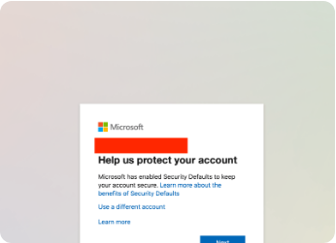
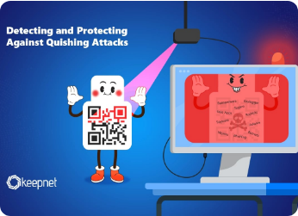
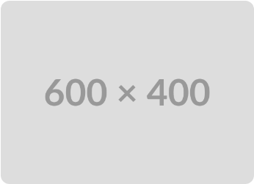
REAL-WORLD EXAMPLES
Brand Impersonation
Mobile Phishing
Financial Fraud
Microsoft is the #1 impersonated brand, used in 25% of all phishing attacks.
QR Code phishing (Quishing) surged 336% in early 2026 as a new stealth vector.
BEC (Business Email Compromise) caused $2.77 billion in losses in 2024.

Slide 10
THE COST OF A CLICK
$4.8M
Hidden Damages
Data Loss & Ransom payments.
Regulatory fines (GDPR/HIPAA).
Average Breach Cost
Permanent Loss of customer trust.

Slide 11

INTERACTIVE QUIZ: SPOT THE PHISH
Scenario: You receive an email from "Service Desk"
Subject: Urgent Security Update Required!
Content: "Your account has a critical vulnerability. Click here to download the security patch: http://it-support-internal.com/patch.exe"
Question: What is the biggest red flag?
A) The urgent subject line.
B) The file extension (.exe) in the link.
C) IT asking you to manually install a patch via email.
D) All of the above.

Slide 12
Stay Secure
Stop & Think: If an email feels urgent, call the sender on a known number.
Enable MFA: Multi-Factor Authentication stops 99.9% of account takeovers.
REPORT: Use the "Report Phish" button. Reporting protects your colleagues.
When in doubt, throw it out!

Slide 13
Any Questions

